Slide 1

Automatic Body Sanitizer Dispenser TEIT B Batch-1
St. Francis Institute of Technology
Department of Information Technology
Mini Project – Sensor Lab (ITL 603)
Monik Kaole 09
Faustina Lazarus 10
Bennet Menezes 11
Dhruv Dave 12
Mentor:
Ms. Minal Lopes
Assistant professor

Slide 2
Overview
Introduction
Literature Review
Problem statement
Architectural Diagram
Methodology
Implementation
Results and Discussion
Conclusion
References

Slide 3
Introduction
Sanitization means cleaning or sterilizing an object or body part like hands or whole body. It can be done in many ways including UV sanitization, soap sanitization, alcohol sanitization, bleach sanitizing etc. Of the above methods, alcohol was found to be more useful for human beings since it is harmless on the skin surface, vaporizes easily and kills most of the viruses, bacteria, and also removes dirt from our hands.
Sanitizers are also provided with antiseptic disinfectants like Chlorhexidine Gluconate. The minimum concentration of alcohol in hand sanitizers must be greater than 70% for effectiveness against viruses. But, repeatedly touching the sanitizer containers to get a drop of sanitizer again initiates contact with persons, which may be risky. Hence, there is a need for a non-contact-based body sanitizer dispenser.

Slide 4
Literature Survey
Sr No | Methodology | Advantages | Future Scope
1. | Automatic Body Sanitizer Tunnel using Arduino and IR Sensor and Temperature detection. | Fast, accurate temperature readings. It gives an almost instantaneous reading, and there is a built in fever alarm to indicate if a temperature is very high | Project can further be developed into various dimensions based upon the requirement

Slide 5
Literature Survey
Sr No | Methodology | Advantages | Future Scope
2. | Door Operated Automatic Sanitizing Machine with Temperature Sensor | Here, they are using microcontroller which is cost effective which takes less time to perform the operation. They perform all the tasks effectively. | Mask detection to be added

Slide 6
Literature Survey
Sr No | Methodology | Advantages | Future Scope
3. | Autonomous Advanced Disinfection Tunnel | An advanced level of disinfection system using two chambers: UV light disinfection and Sanitization. LEDs indicating chamber’s occupancy. | Can be extended to mobile disinfection tunnels for vehicles/two-wheelers and for lightweight chambers.

Slide 7
Problem Statement
Demand for body sanitizers has surged and the coronavirus broke out and spread around the world. But equipment used for this purpose also have some technical flaws as mentioned below.
Each person presses the pump handle differently, making it difficult to predict the amount of use and to manage refills and replacements. Due to this, the actual use of hand sanitizers is reduced, which does not help prevent spread of the virus because of insufficient amount. Some hand sanitizers on the market are automatically pumped.
However, because sanitizer containers and pump devices are designed to be compatible only between products produced by the same manufacturer, consumers must also repurchase the container for the liquid if they replace the hand sanitizer. It is not economical and it has a negative impact on the environment by increasing waste emissions.

Slide 8
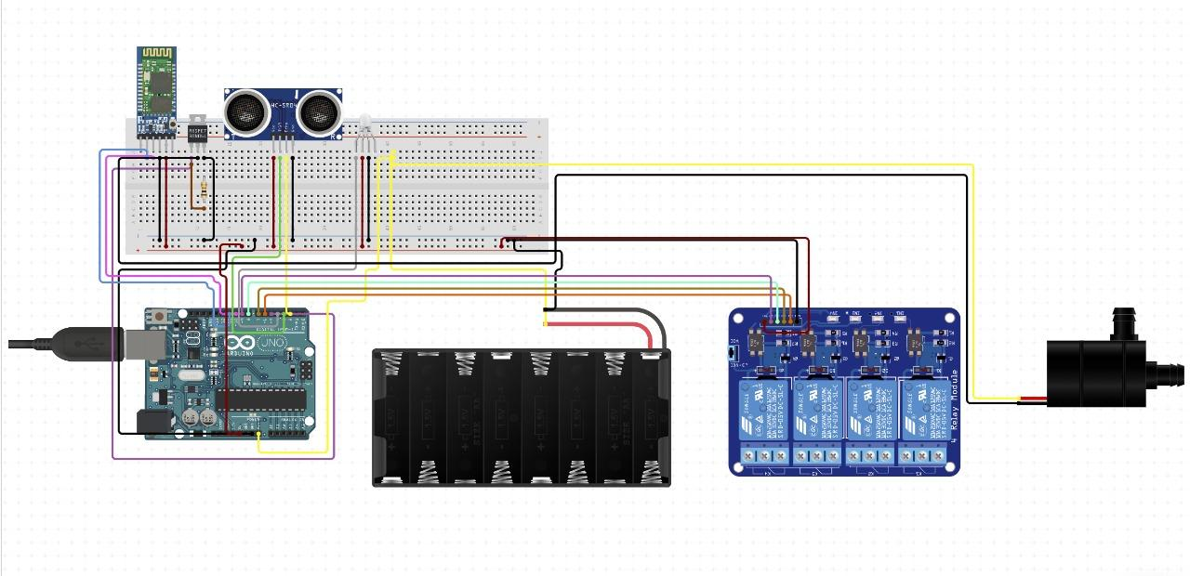
Architectural Diagram

Slide 9
Methodology
We are using ultrasonic technology to detect the distance.
Wireless bluetooth technology has been used to send data to the mobile terminal.
Sanitizer dispenser has been implemented using battery operated pump.

Slide 10
Implementation
We have used ultrasonic sensor HC-SR04 to detect distance of the body from the gate Which sends the signal through the Arduino Uno R3 to the relay module which triggers the sanitizer pump and the sanitizer flows through pipe and nozzle turns the liquid into mist which is then sprayed on human body near the gate.
The distance of the person is also sent to the terminal on mobile phone using Bluetooth module HC-05.

Slide 11
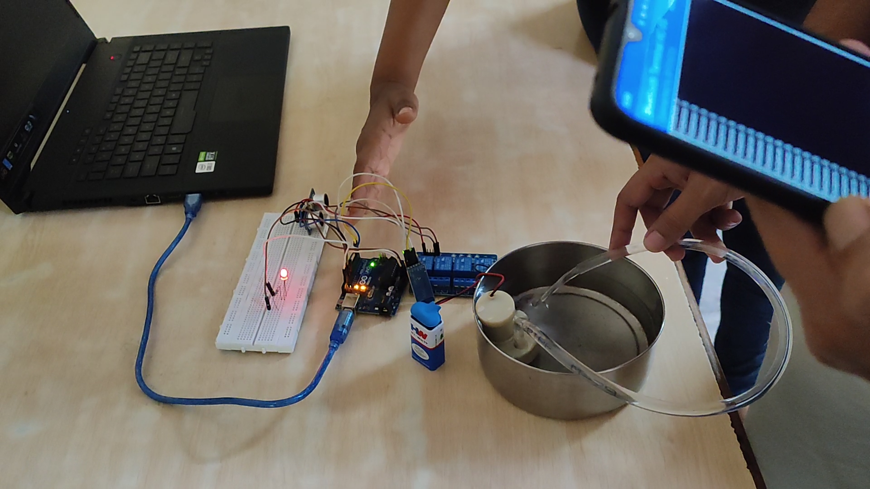
Results and Discussion

Slide 12


Slide 13
Conclusion
Because of the COVID-19 issue, most organisations utilise hand sanitizer machines to eliminate viruses from hands. However, when our bodies come into touch with other bodies, especially if a person has COVID-19 symptoms, it is vital to sanitise not only the hands but also the entire body. As a result, we shall design an automated sanitizer machine for the purpose of body sanitization.
This machine will be more effective than soaps and also contactless, easy to use thus reducing the risk of virus transmission.
Also when we use automatic sanitizer machine, we save the time or sanitizer required for sanitization process.

Slide 14
References
Automatic Body Sanitizer Machine:
https://ijirt.org/master/publishedpaper/IJIRT151877_PAPER.pdf
Accessed on: February 26, 2022
Door Operated Automatic Sanitizing Machine with Temperature Sensor
https://ijarsct.co.in/Paper1670.pdf
Accessed on: February 26, 2022
Review on Automatic Sanitizer Dispensing Machine
Review_on_Automatic_Sanitizer_Dispensing_Machine.pdf
Accessed on: February 26, 2022
Autonomous Disinfection Tunnel
https://www.ncbi.nlm.nih.gov/pmc/articles/PMC7335228/
Accessed on: February 26, 2022.

